Slide 1
Implementation

Slide 2


Introduction
7.1
A digital circuit design is just an idea, perhaps drawn on paper
We eventually need to implement the circuit on a physical device
□ How do we get from (a) to (b)?
k
Belt W ar n
si
p
w
s
IC
(a) Digital circuit design
(b) Physical implementation
Note: Slides with animation are denoted with a small red "a" near the animated items
3

Slide 3
Manufactured IC Technologies
7.2
We can manufacture our own IC
Months of time and millions of dollars
(1) Full-custom or (2) semicustom
(1) Full-custom IC
We make a full custom layout
Using CAD tools
Layout describes the location and size of every transistor and wire
A fab (fabrication plant) builds IC for layout
Hard!
k
BeltWarn
p
w
Custom layout
s
Fab setup costs ("non-recurring engineering", or NRE, costs) high
Error prone (several "respins")
Fairly uncommon
□ Reserved for special ICs that demand the very best performance or the very smallest size/ power
Fab
months
a
IC
4

Slide 4
Manufactured IC Technologies – Gate Array ASIC
(2) Semicustom IC
"Application-specific IC" (ASIC)
(a) Gate array or (b) standard cell
(2a) Gate array
k
BeltWarn
p
w
□ Series of gates already layed out ^{s}
(b)
on chip
We just wire them together
Using CAD tools
Vs. full-custom
Cheaper and quicker to design
But worse performance, size, power
Very popular
(a)
k p
w
s
(d)
(c)
IC Fab
weeks
(just wiring)
a
5

Slide 5

Manufactured IC Technologies – Gate Array ASIC
(2a) Gate array
□ Example: Mapping a half-adder to a gate array
Half-adder equations:
s = a'b + ab' co = ab
a b
ab
a'b
ab'
co
s
Gate array
a
6

Slide 6

Manufactured IC Technologies – Standard Cell ASIC
(2) Semicustom IC
"Application-specific IC" (ASIC)
(a) Gate array or (b) standard cell
(2b) Standard cell
Pre-layed-out "cells" exist in library, not on chip
Designer instantiates cells into pre-defined rows, and connects
Vs. gate array
Better performance/power/size
A bit harder to design
Vs. full custom
Not as good of circuit, but still far easier to design
k
BeltWarn
p
w
s (a)
Cell library
(b)
k p s
w
cell row
cell row
cell row
(d)
(c)
IC Fab
1-3 months
a
(cells and wiring)
7

Slide 7






Manufactured IC Technologies – Standard Cell ASIC
(2b) Standard cell
□ Example: Mapping a half-adder
co = ab
s = a'b + ab'
to standard cells
a b
co s
ab
a'b
cell row
ab'
cell row
a b
ab
a'b
ab'
co
cell row
s
a
Notice fewer gates and shorter wires for standard cells versus gate array, but at cost of more design effort
Gate array
a
8

Slide 8
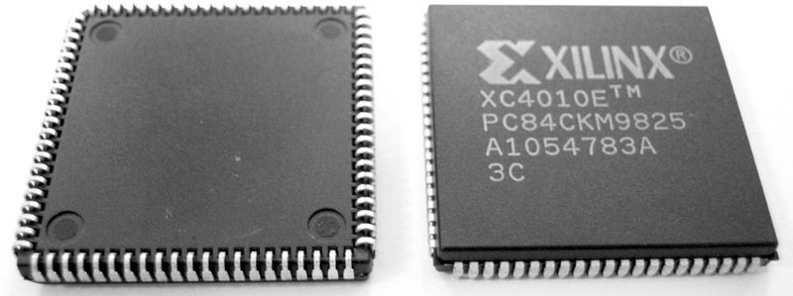
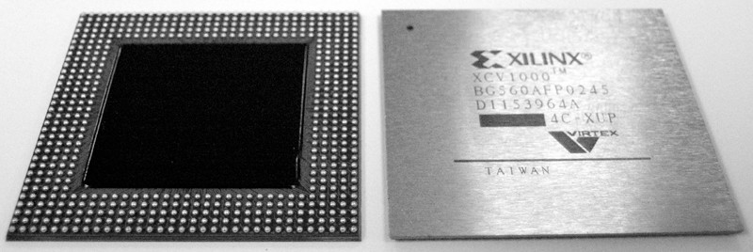
Programmable IC Technology – FPGA
7.3
Manufactured IC technologies require weeks to months to fabricate
And have large (hundred thousand to million dollar) initial costs
Programmable ICs are pre-manufactured
Can implement circuit today
Just download bits into device
Slower/bigger/more-power than manufactured ICs
But get it today, and no fabrication costs
Popular programmable IC – FPGA
"Field-programmable gate array"
Developed late 1980s
Though no "gate array" inside
□ Named when gate arrays were very popular in the 1980s
Programmable in seconds
9

Slide 9
FPGA Internals: Lookup Tables (LUTs)
Basic idea: Memory can implement combinational logic
e.g., 2-address memory can implement 2-input logic
1-bit wide memory – 1 function; 2-bits wide – 2 functions
Such memory in FPGA known as Lookup Table (LUT)
F = x'y' + xy
F = x'y' + xy
G = xy' 4x 2 Mem.
4x 1 Mem. 4x 1 Mem.
1 rd
x y
F
1
rd
0 0
0 1
1 0
1 1
1
0
0
1
x y F G
1
rd ₀
1
2
3
a1 a0
0
1
0
1
2
3
1
0 | 0 | 1 | 0
0 | 1 | 0 | 0
1 | 0 | 0 | 1
1 | 1 | 1 | 0
10
00
01
10
1
0
0
2
0
0
3
1
x=0
1
x
a1 a0
a1 a0
x y
y
D
D
D1 D0
y=0
F
F=1
F G
(e)
(a)
(b)
(c)
(d)
a
a
a
a
10

Slide 10
FPGA Internals: Lookup Tables (LUTs)
Example: Seat-belt warning light (again)
k
BeltWarn
k | p | s | w
0 | 0 | 0 | 0
0 | 0 | 1 | 0
0 | 1 | 0 | 0
0 | 1 | 1 | 0
1 | 0 | 0 | 0
1 | 0 | 1 | 0
1 | 1 | 0 | 1
1 | 1 | 1 | 0
p
w
s (a)
8x1 Mem.
0
1
2
3
0
0
0
0
0
0
1
0
(b)
a
Programming (seconds)
k
p a1 ⁴
s a0 ⁵
6
7
IC
a2
Fab
1-3 months
a
(c)
D
w
11

Slide 11


FPGA Internals: Lookup Tables (LUTs)
Lookup tables become inefficient for more inputs
3 inputs → only 8 words
8 inputs → 256 words; 16 inputs → 65,536 words!
FPGAs thus have numerous small (3, 4, 5, or even 6-input) LUTs
If circuit has more inputs, must partition circuit among LUTs
Example: Extended seat-belt warning light system:
Sub-circuits have only 3-inputs each
kps'
BeltWarn BeltWarn 8x1 Mem. 8x1 Mem.
k k
0
1
2
3
k a2
p a1 ⁴
s
0
0
1
2
3
a2
a1 ⁴
a0 ⁵
6
7
0
1
1
1
1
1
1
1
p _{w} p
x
w
0
s t
s t
0
0
x
0
d
d
a0 ⁵
0
(a)
5-input circuit, but 3- input LUTs available
6
7
1
3 inputs
1 output x=kps'
3 inputs
1 output w=x+t+d
x+t+d
0
D
D
(b) ^{t}
d
w
Partition circuit into
ª 3-input sub-circuits
(c)
Map to 3-input LUTs
a
12

Slide 12
FPGA Internals: Lookup Tables (LUTs)
Partitioning among smaller LUTs is more size efficient
□ Example: 9-input circuit
a b c d e f
a b c
d
F e
f
g h i
3x1
512x1 Mem.
3x1
3x1
F
g h i
8x1 Mem.
3x1
(a)
(b)
(c)
Original 9-input circuit
Partitioned among 3x1 LUTs
Requires only 4 3-input LUTs
(8x1 memories) – much smaller than a 9-input LUT (512x1 memory)
13

Slide 13




FPGA Internals: Lookup Tables (LUTs)
LUT typically has 2 (or more) outputs, not just one
Example: Partitioning a circuit among 3-input 2-output lookup tables
a b c d
8x 2 Mem. 8x 2 Mem.
0
1
2
3
00
00
00
00
00
00
00
01
0
1
2
3
00
10
00
10
00
10
10
10
F
e
(a)
a2
4
c
a2 ₄
1
2
3
a1 a0 ⁵
a1 a0 ⁵
6
7
t
1
2
6
7
d e
F
3
D1 D0
D1 D0
(b)
t
(Note: decomposed one 4- input AND input two smaller ANDs to enable partitioning into 3-input sub-circuits)
d
F
a
e
(c)
First column unused; second column implements AND
Second column unused; first column implements AND/OR sub-circuit
a
14

Slide 14
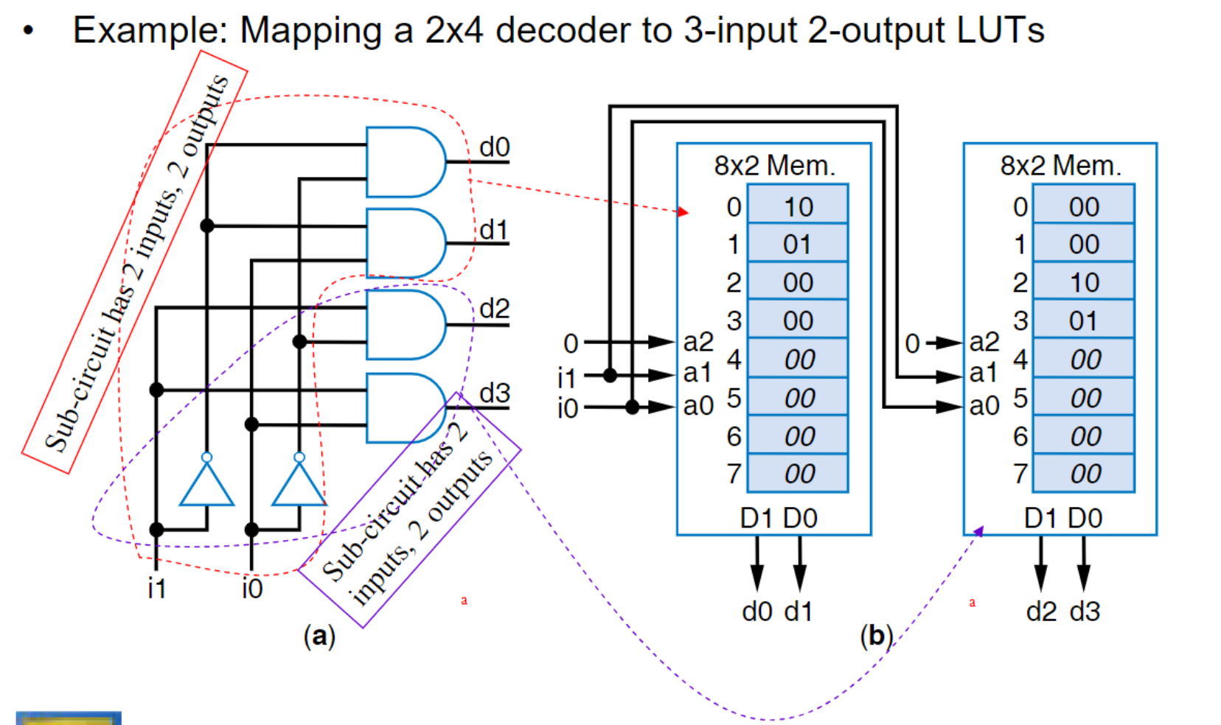


FPGA Internals: Lookup Tables (LUTs)
Example: Mapping a 2x4 decoder to 3-input 2-output LUTs
d0
8x2 Mem.
8x2 Mem.
0 10
1 01
2 00
3 00
0
1
2
3
00
00
10
01
00
00
00
00
d1
Sub-circuit has 2 inputs, 2 outputs
d2
0
i1 i0
a2 ₄
00
0 a2 ₄
a1
5 00
a1
5
d3
a0
a0
6 00
7 00
D1 D0
6
7
Sub-circuit has 2
D1 D0
inputs, 2 outputs
i1
i0
a
d0 d1
a
d2 d3
(a)
(b)
15

Slide 15
FPGA Internals: Switch Matrices
Previous slides had hardwired connections between LUTs
Instead, want to program the connections too
Use switch matrices (also known as programmable interconnect)
□ Simple mux-based version – each output can be set to any of the four inputs just by programming its 2-bit configuration memory
FPGA (partial) ^{Switch matrix}
8x2 Mem.
8x2 Mem.
2-bit memory
0 00
1 00
2 00
3 00
^{a2} 4 00
0 00
1 00
2 00
3 00
m0
i0
s1 s0
P0
P1 P2 P3
m1
i1 4x1 _{d} o0
P6 P7
m2
i2 mux i3
a1
^{a2} 4 00
m3
o0 o1
a1
_{a0} 5 00
m0 m1 m2 m3
_{a0} 5 00
6 00
7 00
6 00
7 00
2-bit memory
D1 D0
Switch matrix
D1 D0
s1 s0
i0
P8 P9
i1 4x1 _{d} o1
i2 mux i3
P4 P5
(a)
(b)
a
a
16

Slide 16
FPGA Internals: Switch Matrices
Mapping a 2x4 decoder onto an FPGA with a switch matrix
These bits establish the desired connections
FPGA (partial)
Switch matrix
8x2 Mem.
8x2 Mem.
10
0 10
1 01
2 00
3 00
00
00
0
1
2
3
00
00
10
01
00
00
00
00
m0
i0
s1 s0
0
0
i1 i0
m1
i1 4x1 _{d}
o0
d3 d2
m2
i2 mux i3
a2 ₄
a2 ₄
m3
a1 a0 ⁵
6 00
7 00
10 ^{o0} m0 ₁₁ o1
a1 a0 ⁵
6
7
m1 m2 m3
Switch matrix
11
D1 D0
D1 D0
i0
s1 s0
d1 d0
i1 4x1
o1
i2 mux ^{d} i3
i1 i0
(a)
(b)
a
17

Slide 17

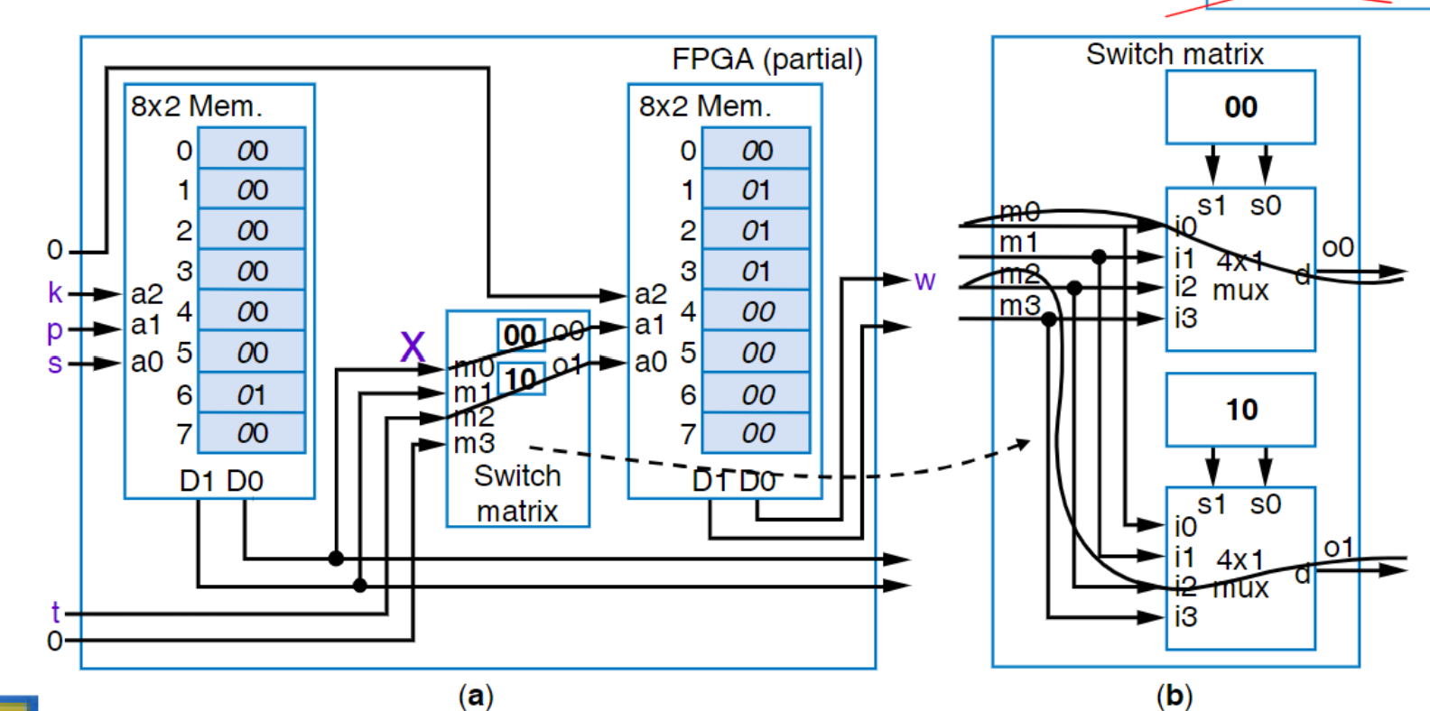
FPGA Internals: Switch Matrices
k
BeltWarn
Mapping the extended seatbelt warning light onto an FPGA with a switch matrix
□ Recall earlier example (let's ignore d input for simplicity)
p
x
w
s t
d
FPGA (partial)
Switch matrix
8x 2 Mem.
8x2 Mem.
00
0 00
1 00
2 00
3 00
0
1
2
3
00
01
01
01
00
00
00
00
m0
s1 s0 i0
0
k p s
m1
i1 4x 1 _{d}
o0
a2 ₄
a2 ₄
w
m2
i2 mux i3
_{a1} 00
_{a0} 5 00 x _{m0}
6 01
7 00
a1 a0 ⁵
6
7
m3
00 ^{o0}
_{m1} 10
o1
m2 m3
Switch matrix
10
D1 D0
D1 D0
s1 s0
i0
i1 4x 1 _{d} ^{o1}
i2 mux i3
t 0
(a)
(b)
a
18

Slide 18
FPGA Internals: Configurable Logic Blocks (CLBs)
LUTs can only
implement combinational logic
FPGA
CLB
CLB
8x 2 Mem.
8x 2 Mem.
Need flip-flops to
0 00
1 00
2 00
3 00
0 00
1 00
2 00
3 00
implement sequential logic
P0 P1
P2 P3
a2
a2
_{a1} 4 00
_{a0} 5 00
6 00
7 00
_{a1} 4 00
_{a0} 5 00
6 00
7 00
Add flip-flop to each
00 ^{o0}
m0
o1
LUT output
□ Configurable Logic
_{m1} 00
m2 m3
CLB output flip-flop
D1 D0
Switch matrix
D1 D0
Block (CLB)
LUT + flip-flops
□ Can program CLB outputs to come from flip-flops or
1-bit CLB
output configuration memory
₀ 1 0 ₀ 1 0
2x 1 2x 1
₀ 1 0 ₀ 1 0
2x 1 2x 1
P6 P7 P8 P9
from LUTs directly
P4 P5
a
19

Slide 19
FPGA Internals: Sequential Circuit Example using CLBs
a
b c
d
FPGA
CLB
CLB
8x 2 Mem.
8x 2 Mem.
0
1
2
3
a2 ₄
11
10
01
00
00
00
00
00
0
1
2
3
a2 ₄
00
01
10
11
00
00
00
00
0
0
a b
w
x y
(a)
z
a1
5
₁₀ o0
a1
5
a0
m0 ₁₁ o1
a0
6
7
m1 m2 m3
Switch matrix
6
7
Left lookup table
D1
D0
D1
D0
a2 0 | a1 a | a0 b | D1 w=a' | D0 x=b'
0 | 0 | 0 | 1 | 1
0 | 0 | 1 | 1 | 0
0 | 1 | 0 | 0 | 1
0 | 1 | 1 | 0 | 0
1 0 1 0
¹ 2 x1 ¹ 2 x1
1 0 1 0
¹ 2 x1 ¹ 2 x1
z y x w
below unused (b)
c
d
(c)
a
20

Slide 20
FPGA Internals: Overall Architecture
Consists of hundreds or thousands of CLBs and switch matrices (SMs) arranged in regular pattern on a chip
Represents channel with tens of wires
Connections for just one CLB shown, but all CLBs are obviously connected to channels
CLB
CLB
CLB
SM
SM
CLB
CLB
CLB
SM
SM
CLB
CLB
CLB
21

Slide 21
FPGA Internals: Programming an FPGA
All configuration
FPGA
memory bits are connected as one big shift register
□ Known as scan chain
CLB
CLB
Pin
8x2 Mem.
8x2 Mem.
0 11
1 10
2 01
3 01
^{a2} 4 00
0
1
2
3
01
00
11
10
00
00
00
00
Pclk
0
0
a b
a2 ₄
a1
5 00
10 ^{o0} m0 ₁₁ o1
a1
5
a0
6 00
7 00
a0
6
7
(a)
m1 m2 m3
Switch matrix
D1 D0
D1
D0
Shift in "bit file"
of desired circuit
1 2 x1 1 2x1
1 2 x1 1 2 x1
z y x w
c
(b)
d
Pin
Conceptual view of configuration bit scan chain is that of a 40-bit shift register
Pclk
a
(c) Bit file contents for desired circuit: 1101011000000000111101010011010000000011
This isn't wrong. Although the bits appear as "10" above, note that the scan chain passes through those bits from right to left – so "01" is correct here.
22

Slide 22

Other Technologies
I1 I2 I3
Simple Programmable Logic Devices (SPLDs)
Developed 1970s (thus, pre-dates FPGAs)
Prefabricated IC with large AND-OR structure
Connections can be "programmed" to create custom circuit
Circuit shown can implement any 3- input function of up to 3 terms
□ e.g., F = abc + a'c'
O1
PLD IC
programmable nodes
23

Slide 23



Programmable Nodes in an SPLD
Fuse based – "blown" fuse removes
connection
Memory based – 1 creates connection
I1 I2 I3
programmable node
Fuse based
(a)
O1
Fuse
"unblown" fuse "blown" fuse
Memory based
PLD IC
mem 1
mem 0
programmable nodes
(b)
24

Slide 24







PLD Drawings and PLD Implementation Example
Common way of drawing PLD connections:
Uses one wire to represent all inputs of an AND
Uses "x" to represent connection
Crossing wires are not connected unless "x" is present
Example: Seat belt warning
I1 I2 I3
wired AND
*
× ×
I3 I2'
O1
PLD IC
k p s
light using SPLD
k
BeltWarn
kps'
× × ×
p
w
××
×× ×× ××
Two ways to generate a 0 term
0
w
s
0
PLD IC
25

Slide 25
More on PLDs
Originally (1970s) known as Programmable Logic Array – PLA
Had programmable AND and OR arrays
AMD created "Programmable Array Logic" – "PAL" (trademark)
Only AND array was programmable (fuse based)
Lattice Semiconductor Corp. created "Generic Array Logic – "GAL" (trademark)
Memory based
As IC capacities increased, companies put multiple PLD structures on one chip, interconnecting them
Become known as Complex PLDs (CPLD), and older PLDs became known as Simple PLDs (SPLD)
GENERALLY SPEAKING, difference of SPLDs vs. CPLDs vs. FPGAs:
SPLD: tens to hundreds of gates, and usually non-volatile (saves bits without power)
CPLD: thousands of gates, and usually non-volatile
FPGA: tens of thousands of gates and more, and usually volatile (but no reason why couldn't be non-volatile)
26

Slide 26
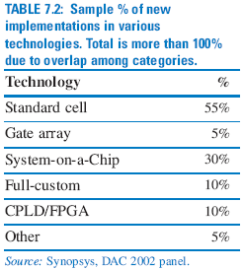
Technology Comparisons
7.5
Full-custom Standard cell (semicustom)
Gate array (semicustom)
FPGA
PLD
Quicker availability Lower design cost
Faster performance Higher density Lower power
Larger chip capacity
More optimized
Easier design
27

Slide 27
Technology Comparisons
: Custom processor in full-custom IC
Highly optimized
: Custom processor in FPGA
Parallelized circuit, slower IC technology but programmable
: Programmable processor in standard cell IC
Program runs (mostly)
sequentially on moderate-costing IC
: Programmable processor in FPGA Not only can processor be programmed, but FPGA can be programmed to implement multiple processors/coprocessors
Custom
(2)
(1)
Processor varieties
processor
More optimized
Easier degsni
Programmable processor
(4)
(3)
PLD FPGA
Gate Standard Full-custom array cell
IC technologies
28

